Slide 1
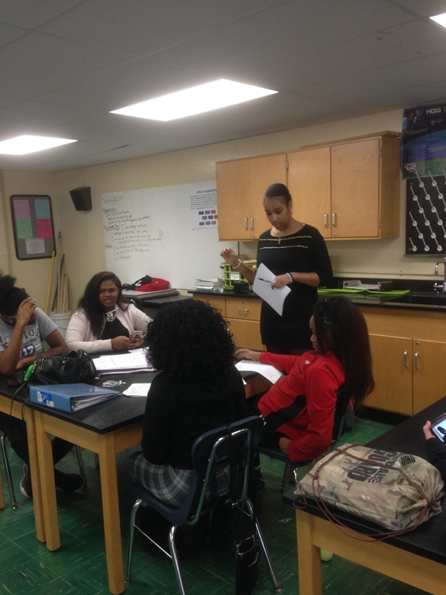
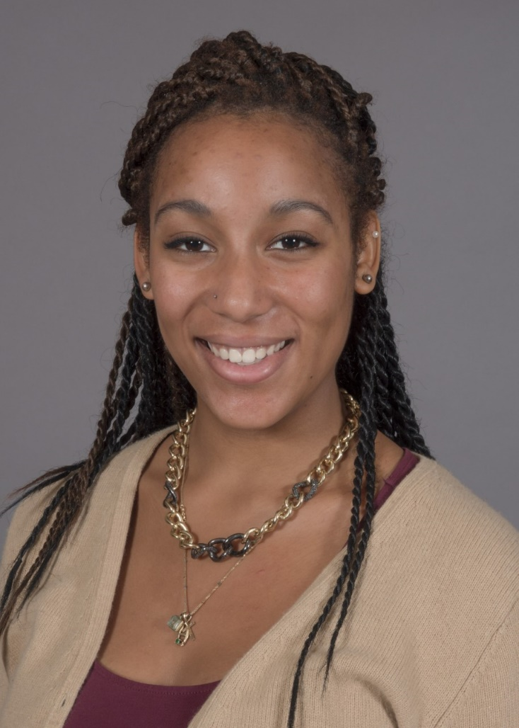
Neah Gray Senior in CEAS Environmental Engineering
Finneytown High School
Environmental Science
Grades 10th-12th

Slide 2
Clean water and Desalination How do we make clean water?
Academic Content Standards: Ohio Science Standards- EVS
Earth resources (Water pollution)
Global Environmental Problems and Issues
Next Generation Science Standards:
Science and Engineering Practices-
Asking questions and defining problems
Developing and using models
Analyzing and interpreting data
Obtaining, evaluating, and communicating information
Crosscutting Concepts-
Cause and effect, Systems and system models
Structure and function

Slide 3
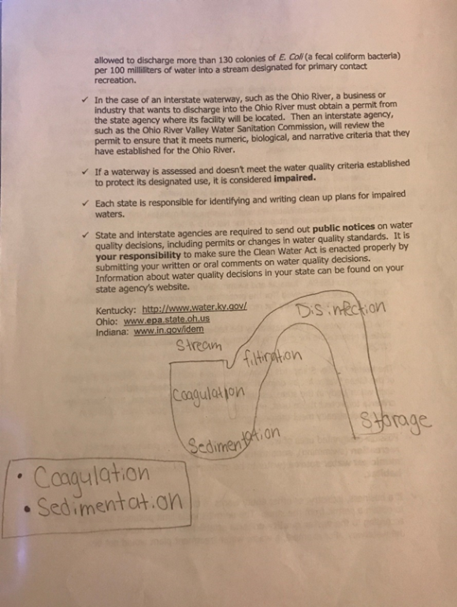
Clean Water and Solar Stills
Guiding Questions:
What are some issues regarding water in today’s society?
What is clean water? How do we know?
What are the different uses of water and how does the quality vary from purpose to purpose?
What are the steps in the water purification?
How do you create a solar still that utilizes the steps in water purification?
Objectives:
Identify some big issues regarding water in today’s society.
Define clean water.
Compare and contrast the different purposes of water.
Identify the steps in water purification.
Design a solar still that utilizes the steps in water purification.

Slide 4
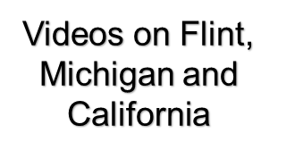
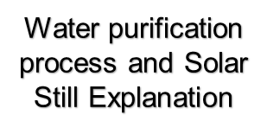
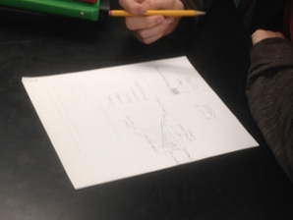
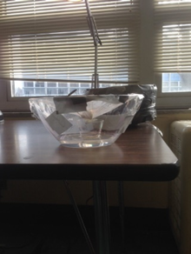
Activity: Designing of Solar Stills

Slide 5
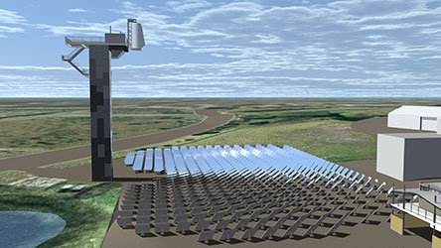
ACS
Application-
World clean water crisis (i.e. Flint, MI and SoCal)
Industrial Solar Stills used in some countries to purify sea water
Careers-
Cincinnati Water Works
EPA
Peace Corps
Societal Impact-
Increase clean water supply
Large issue in the world today

Slide 6
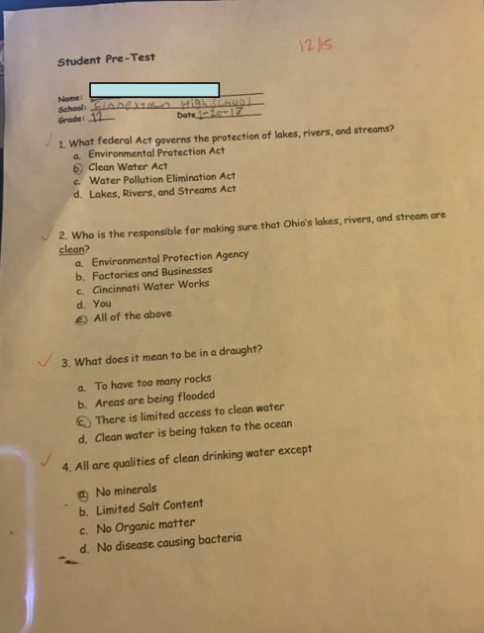
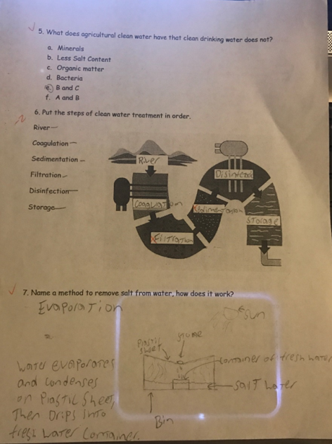
Student Learning
Initial Average: 39%
Post Average: 75%
Improvement of 36% of class overall
Higher scores from 16/19 Students

Slide 7
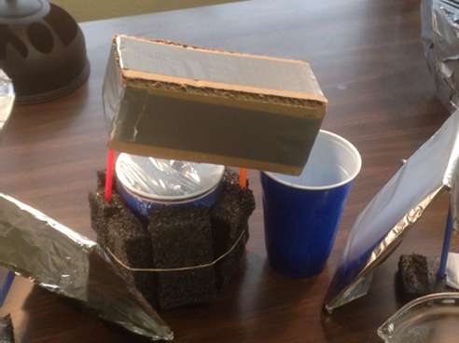
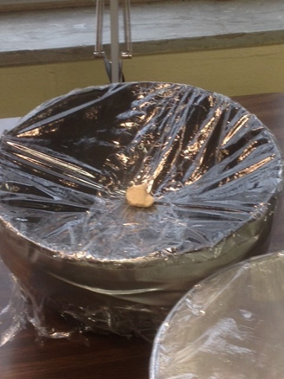
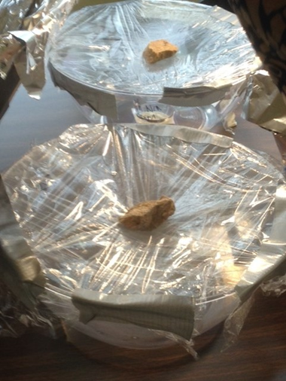
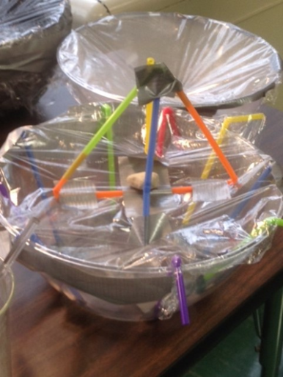
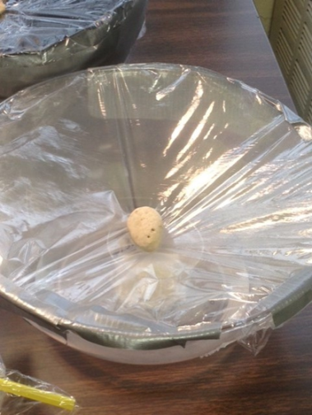
Reflection
Overall success
Students enjoyed the interactive portion of the lesson
Creativity and modeling
Good Comprehension of the concepts of real world applications
Extended response question was helpful in Assessment
will not utilize the PollEverywhere app
Too much idol time- Loss of attention

